Slide 1
News Feed App
Submitted in the partial fulfillment for the award of the degree of
BACHELOR OF ENGINEERING
IN
INTERNET OF THINGS
Submitted by:
Amayra 20bcs4544
Anshumaan Sanjay 20bcs4545
Neha Sharma 20bcs4576
Under the Supervision of:
Rajat Tiwari
Department of AIT-CSE
DISCOVER . LEARN . EMPOWER

Slide 2
Outline
Introduction to Project
Problem Formulation
Objectives of the work
Methodology Used
System Requirement Analysis
Results and Outputs
Conclusion
Future Scope
References

Slide 3
Introduction to Project
The purpose of the project is to develop an application which will display news articles. A news application is a big interactive database that tells a news story.
By showing each reader data that is specific to them, a news app can help each reader understand a story in a way that’s personally meaningful to them.

Slide 4
“News feed application” will give you an easy access to news throughout the day and keeps you updated. It covers in-depth reporting of the current happenings in the country. Due to the growing use of android platform software cell phones, the need of a new and genuine android application is increasing. This app does exactly what it promises and includes some other useful features as well.

Slide 5
Problem Formulation
There are multiple news-sharing apps used by a single user and are often spammed with notifications. There is also a lot of fake news which gets shared.
A news-sharing app wants to help users find relevant and important news easily every day and also understand explicitly that the news is not fake but from proper sources.

Slide 6
Objectives of the Work
The objective of the project is to develop a application for News feed app that can aware the people and provide the daily breaking news.
It makes use of various technologies to get required information quickly, easily, colorfully and attractively.
Anytime, anywhere, anyone can know about the news or information by internet and User will be able to share news easily on social media.

Slide 7
Methodology Used
News feed App
Main Activity class/main.xml file
The Fragment Class
MyPage Adapter
HOME
SPORTS
ENTERTAINMENT
HEALTH
SCIENCE
TECHNOLOGY
Postman API Monitoring
Collecting News APIs
Firebase monitoring

Slide 8
System Requirement Analysis
Android Studio –
Android Studio is the Integrated Development Environment for Android app
development.
Features –
A fast and feature-rich emulator.
A unified environment where you can develop for all android
devices.

Slide 9
API –
News API has been used for collecting different news sources at one spot.
Postman –
The Postman API allows you to programmatically access data stored in
Postman account with ease.
Android mobile device –
The Android operating system is a mobile operating system that was developed by
Google to be primarily used for touchscreen devices, cell phones, and tablets.
Internet connectivity, laptop with Windows 7 and above.

Slide 10
Language Used
Java –
Java is an Object Oriented Programming structure that can be
used to create complete applications that may run on a single
computer or be distributed among servers and clients in a
network.
Java technology is used for developing both applets and
applications.

Slide 11
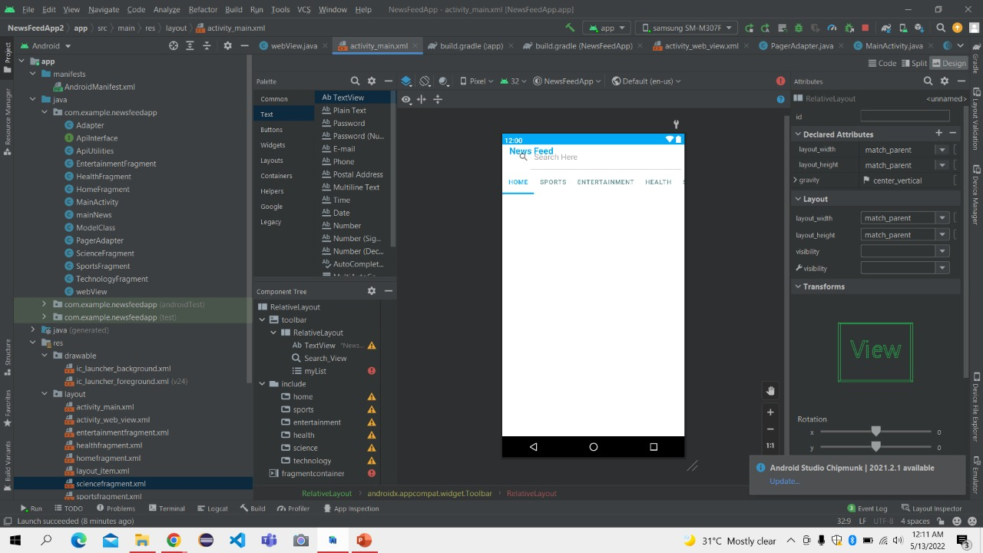
Results and Outputs

Slide 12
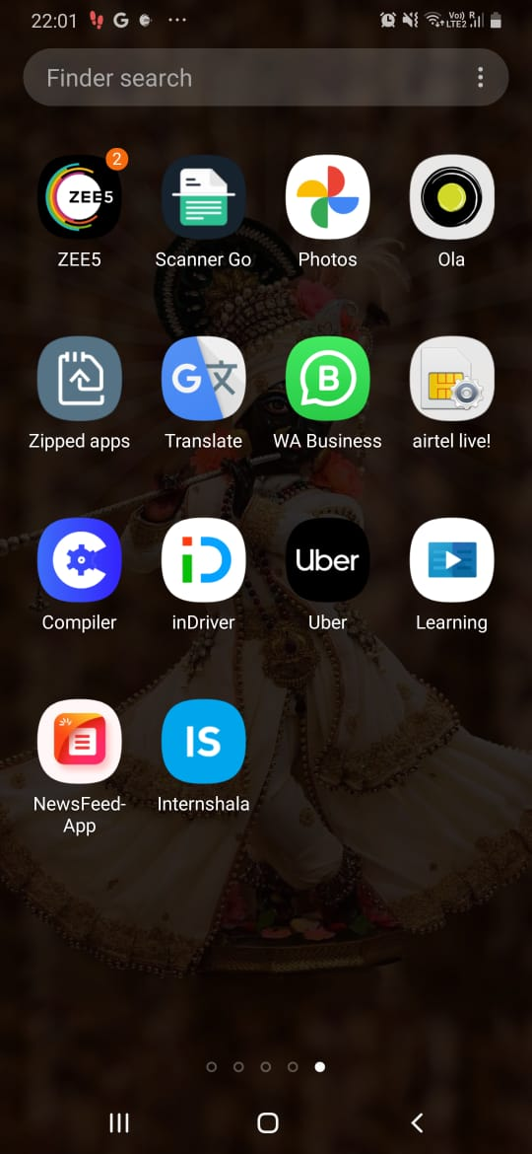
Results and Outputs
Here is the App icon

Slide 13
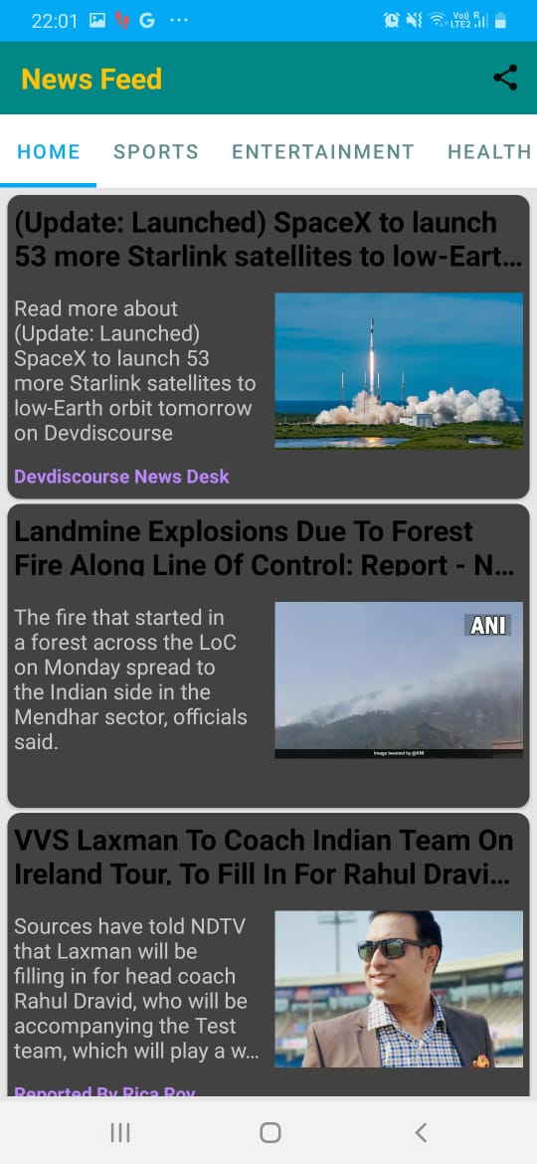
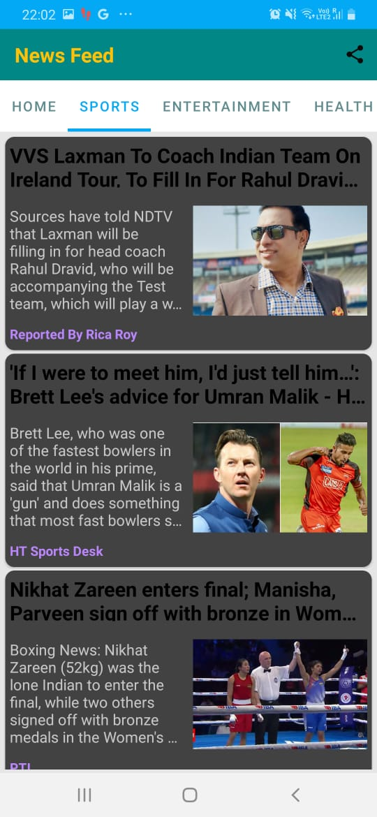
Results and Outputs
Here Home Fragment and
Sports Fragment

Slide 14
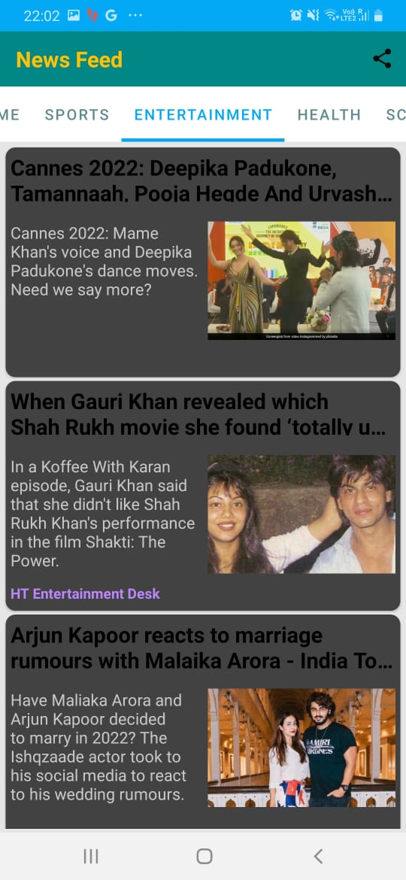
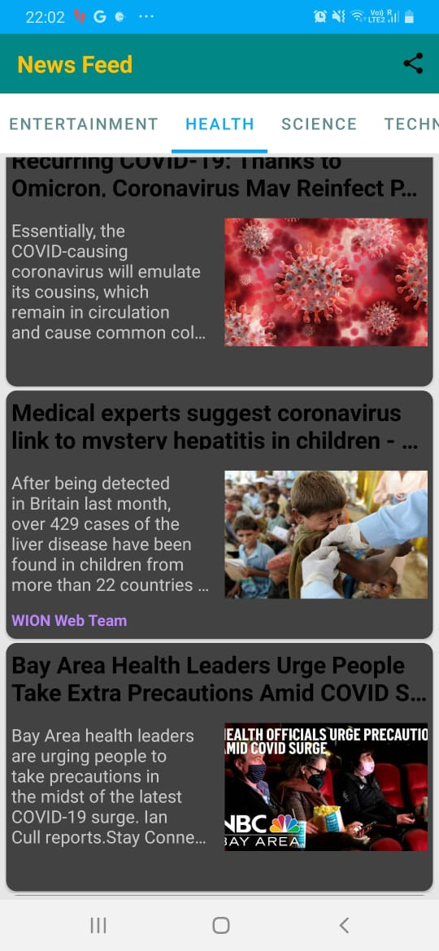
Results and Outputs
Here Entertainment Fragment and
Health Fragment

Slide 15
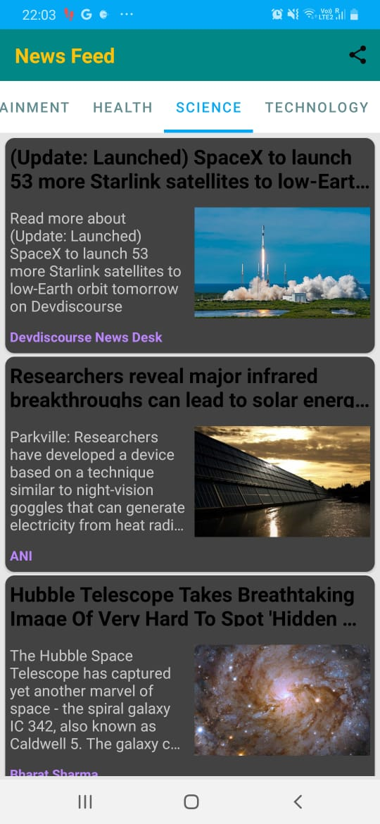
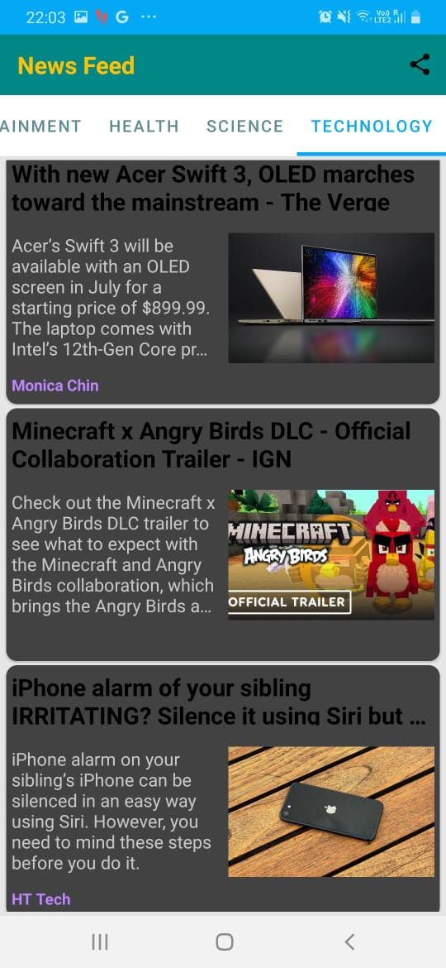
Results and Outputs
Here Science Fragment and
Technology Fragment

Slide 16
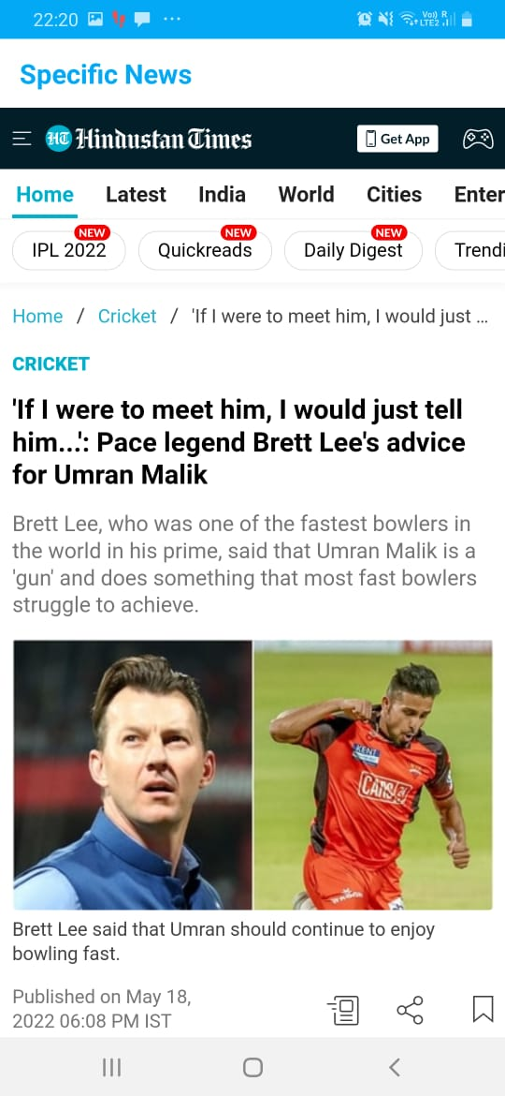
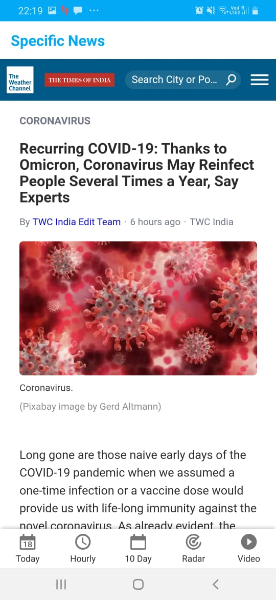
Results and Outputs
Specific News of Sports and Health

Slide 17
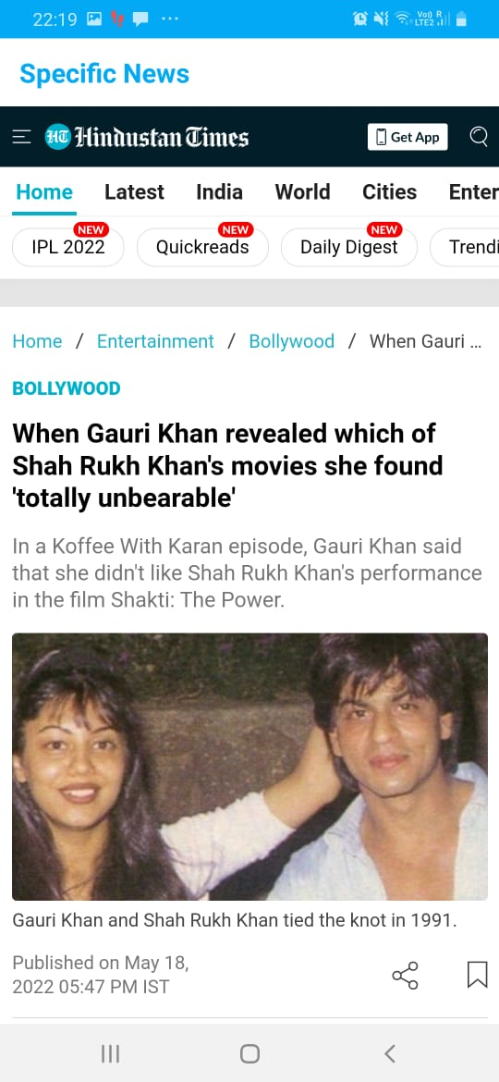
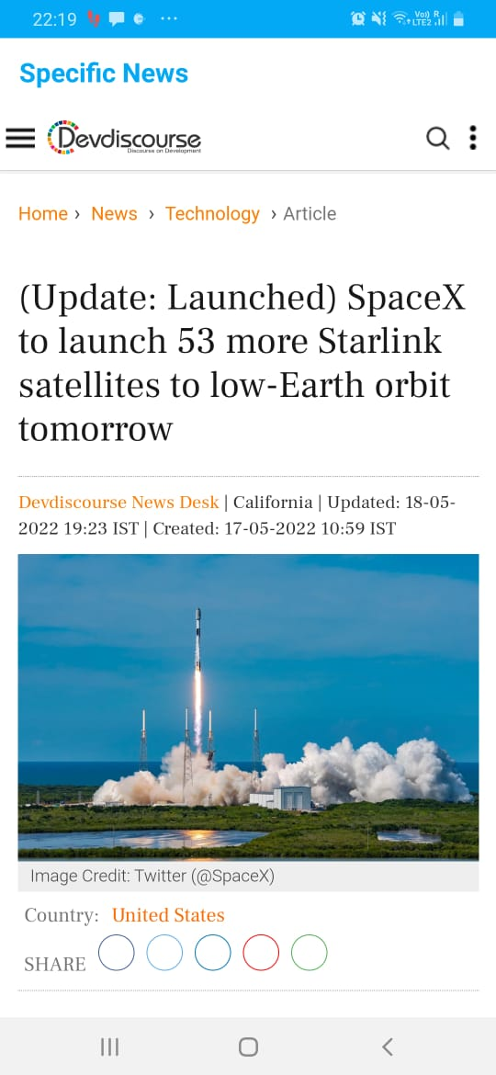
Results and Outputs
Specific news of Science Fragment and
Entertainment

Slide 18
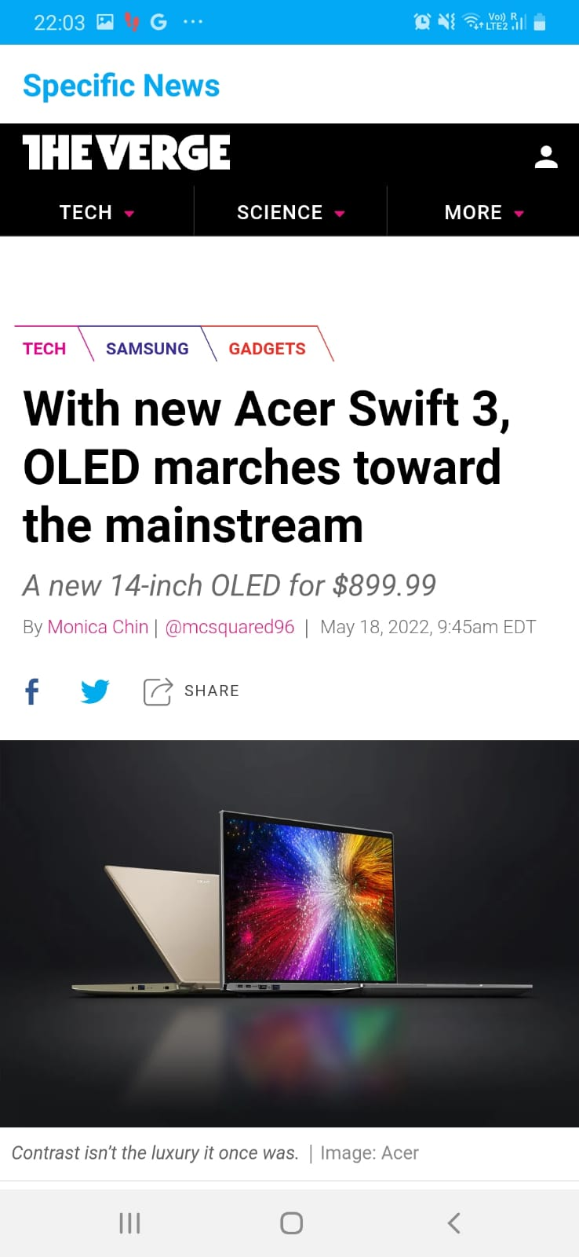
Results and Outputs
Specific news of Technology

Slide 19
Results and Outputs
Here is the sharing icon

Slide 20
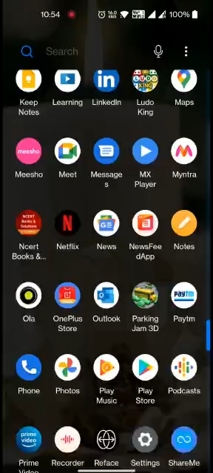
Output video:

Slide 21
Available Features
Short News:- News will be displayed in short format with title, image and little description in list view. It will help user to access required news faster.
Sharing: User will be able to share news easily on social media.
Specific news: Specific news will be displayed according to the need of user. They can select which news the wants to fetch either sports or health or science or technology.

Slide 22
Conclusion
In our project work, an attempt has been made to develop a News or information based app. We develop this project that helps the people and make them aware so that they can know any news on their finger tips .
To establish this app we use various methodologies.
To develop this project we have faced many problem but we hardly tried to develop this project.

Slide 23
Future Scope
In future we will provide location feature with automation can be implemented with means as user move from one city to other local news will change per it.
Data quality check needed.
As new ideas comes into the brain, we are going to implement them and provide the update soon to users.
In future we are going to add more features as per the Feedback received.

Slide 24
References
https://www.tandfonline.com/doi/pdf/10.1080/21670811.2012.740273
https://arulmjoseph.com/need-develop-online-news-portal-2017
https://www.youtube.com/watch?v=O5Oy1226LX4&t=3349s
https://www.blazemeter.com/blog/how-use-postman-manage-and-execute-your-apis/

Slide 25
THANK YOU

